Slide 1
Project Presentation of Co-Op Project at Industry
On
The Dead Theory of Content
Presented by:
Anika Kaushish ( 2210990113)
Gursimran Singh (2210990351)
Gursahaj Singh (2210990349)
Supervised by:
Dr. Gurpreet Singh
Department of Computer Science and Engineering,
Chitkara University, Punjab

Slide 2
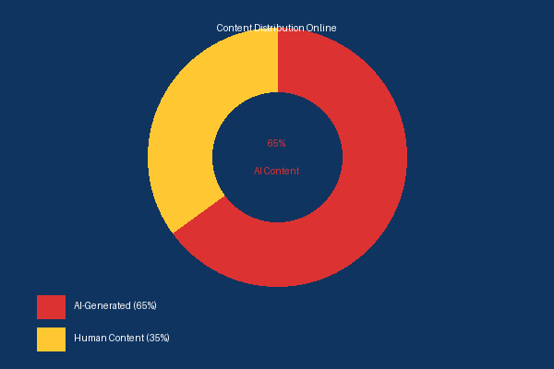
Introduction
What is this research about?
Artificial intelligence can now generate text, images, videos, and music at unprecedented scale. Today, a significant portion of online content — blogs, social media posts, news articles — is created by AI rather than humans.
This trend has given rise to the Dead Theory of Content — the idea that human-created content is losing visibility and value in an AI-dominated digital landscape.
This research explores the psychological, economic, and societal impacts of this shift, and proposes solutions to preserve authenticity online.
65%
of internet traffic is estimated to be AI-generated

Slide 3
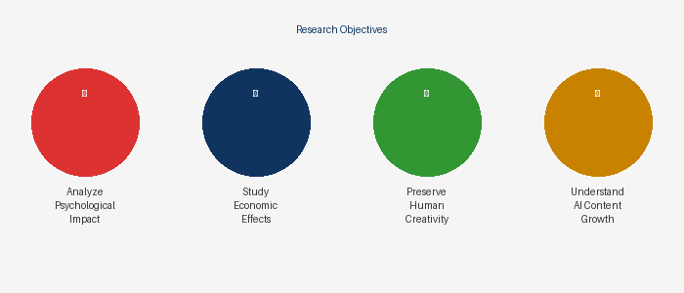
Objectives of the Study
01. Understand Dead Theory
Examine how AI-generated content growth is reshaping the digital landscape
02. Analyze Psychological Impact
Study reduced trust, digital fatigue, and information overload on users
03. Examine Economic Effects
Assess automation's impact on media, marketing, and content industries
04. Preserve Human Creativity
Explore the future of authentic, original human expression online

Slide 4
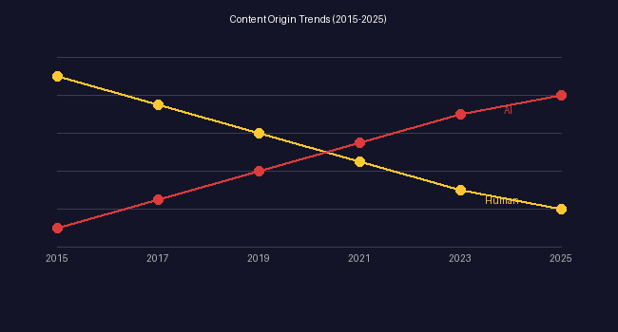
Dead Theory of Content
The Core Concept
The Dead Theory of Content describes the gradual decline of human-generated content as AI floods digital platforms with automated material.
AI bots now generate articles, blogs, posts, images, and videos at a rate impossible for humans to match — reducing the visibility and perceived value of genuine human creativity.
Authenticity
Hard to verify real content
Originality
Human expression devalued
Reliability
Misinformation risk grows

Slide 5
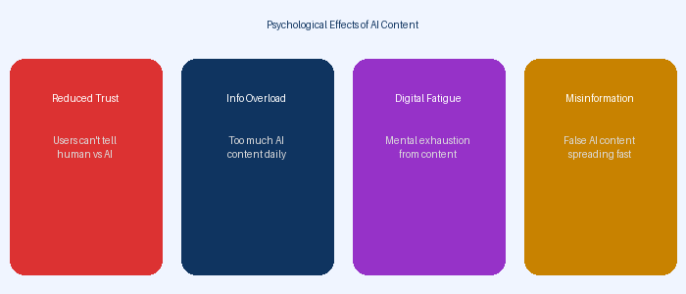
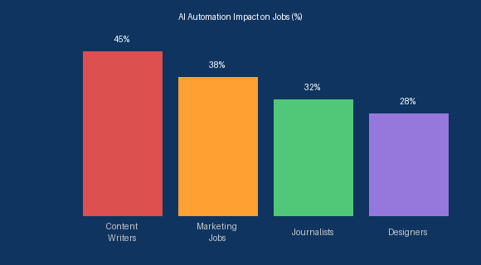
Impact Analysis
Psychological Impact
Economic Impact
Reduced Trust in online information sources
Information Overload from mass AI content
Digital Fatigue and confusion among users
Automation transforming content industries
Job Displacement in writing, media, marketing
Reduced Costs but fewer human creators
AI Tools Market growing exponentially

Slide 6
Challenges, Ethics & Future Outlook
⚠ Challenges & Ethical Issues
🔎 Future of Content Creation
❌
Misinformation & Fake Content
©
Copyright & Ownership Issues
🤝
Human-AI Collaboration
⚖
AI Content Regulation
📝
Loss of Human Originality
📢
Manipulation of Public Opinion
✅
Content Authenticity Standards
🎨
Value Human Creativity

Slide 7
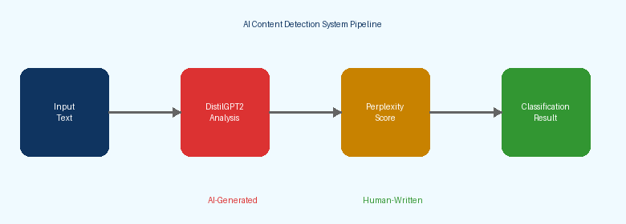
Proposed Solution
AI-Based Content Detection System: Hybrid Deep Learning + Statistical Approach
DistilGPT2 Model
Classifies text with probability scores
Perplexity Scoring
Statistical method for detection accuracy
Future: Multi-Class
Advanced ML with real-world datasets

Slide 8
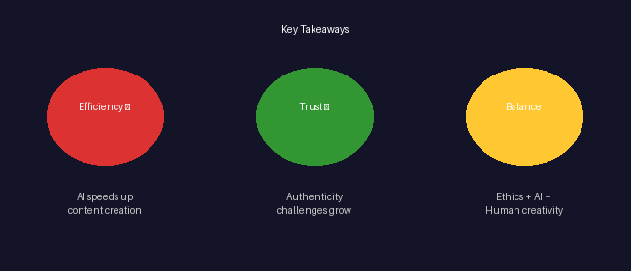
Conclusion
AI-generated content is rapidly transforming the digital world, bringing both efficiency advantages (speed, cost reduction, accessibility) and serious challenges (authenticity, misinformation, employment disruption).
To preserve a healthy digital ecosystem, we must promote ethical AI practices, ensure content transparency, and safeguard genuine human creativity in the age of AI.

Slide 9
THANK YOU

